Slide 1
Abnormal Labor

Slide 2
Outline
Introduction
Definition of abnormal labor
Discuss about:
Disorders of the Latent Phase
Disorders of the Active Phase
Disorders of the Second Stage
Disorders of the Third Stage
Outline etiologies of abnormal labor
Discuss about diagnosis of abnormal labor
Summarize options of management of abnormal labor

Slide 3
Introduction
Labor:- A spontaneous, coordinated, effective sequence of involuntary, painful uterine contractions that result in progressive effacement and dilatation of the cervix; and voluntary bearing down efforts leading to the expulsion of products of conception per vaginum.
(often accompanied by a bloody discharge - bloody show )

Slide 4
Introduction Cont…
Criteria for normal labor:-
At term
Spontaneous onset
Vertex presentation
Vaginal delivery
With out due prolongation
Natural termination with minimal aid
Without any complication to the mother and/or baby

Slide 5
Abnormal Labor
Abnormal labor - any labor in which the pattern of labor progress is significantly different from accepted and recognized patterns of labor progress in terms of cervical changes, decent of fetal presenting part or profile of uterine contractions.
Dystocia - difficult labor

Slide 6
Labor Classification
Labor
1st Stage
Latent
Active
3rd Stage
2nd Stage
?4th Stage

Slide 7
Patterns Of Abnormal Labor
Prolongation disorders
Longer duration than normal
Protraction disorders
Slower progress than normal
Cervical dilatation or decent of fetal presenting part
Arrest disorders
Complete cessation of progress
Cervical dilatation or decent of fetal presenting part
Precipitous labor
Shorter duration than normal

Slide 8
Disorders Of The Latent Phase
Only a prolongation disorder is recognized in LFSOL
Prolonged LFSOL
A latent phase lasting > 20 hours in Nulliparas & > 14 hours in Multiparas.
The onset of latent labor is considered to be the point at which regular & painful uterine contractions are perceived.
> 8 hours for both when true labor is confirmed.

Slide 9
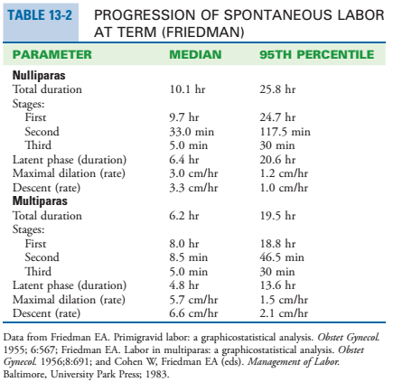
1

Slide 10
Management
Therapeutic rest
Bed rest
Analgesics
Rehydration (Preferably PO)
Oxytocin (Augmentation of labor)
CS delivery for any identified urgent indication

Slide 11
Disorders Of The Active Phase
Protraction disorders
Protracted Active Phase Dilatation
Cervical dilation rate of < 1.2 cm/hr for Nulliparas & < 1.5 cm/hr for Multiparas (Traditional Def.)
(MOH-E 2021)
< 1 cm /hr cervical dilation for a minimum of 4 hours

Slide 12
Cont…
-- Protracted Descent
A decent rate of < 1 cm/hr for Nulliparas & < 2 cm/hr for Multiparas; for a minimum of 4 hrs

Slide 13
Management
Expectant / Support / Observation
Artificial Rupture of Membrane (ARM)
Augmentation
CS for CPD or contraindication for oxytocin use

Slide 14
Disorders of the Active Phase Cont…
Arrest disorders
Secondary arrest of dilatation
No cervical dilatation for > 2 hrs (for both)
Arrest of descent
No decent of fetal presenting part for 1 hr
Failure of Descent
No descent in deceleration phase

Slide 15
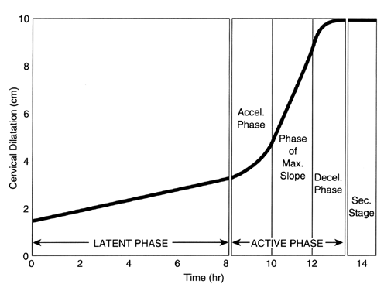

Slide 16
Management
Augmentation if no contraindication
CPD - CS
Contraindication for augmentation – CS

Slide 17
Cont…
NB:- As long as the fetal and maternal status are reassuring, the diagnosis of arrest of active-phase cervical dilation in the first stage of labor should be reserved for women at:
Cervical dilation ≥5 cm with ruptured membranes
And one of the following
Fail to progress despite 4 hours of adequate uterine activity (≥ 200 Montevideo units in a 10-minute period)
At least 6 hours of oxytocin administration but inadequate contractions

Slide 18
Disorders Of The Second Stage
Prolonged second stage
Without epidural > 3 hrs-Nulliparas; > 2 hrs-Multiparas
With epidural > 4 hrs-Nulliparas ;> 3 hrs-Multiparas
Protraction of descent - < 1 cm/hr
Failure of descent (“Arrest”)
No descent in second stage
Notes:
The median duration of the second stage is 50 to 60 minutes for nulliparas and 20 to 30 minutes for multiparas, but the range of second-stage duration is highly variable.

Slide 19
Cont…
Diagnoses of disorders of the second stage requires careful evaluation of five factors:
Uterine activity
Maternal expulsive efforts
Fetal heart rate status
Fetal position
Clinical pelvimetry

Slide 20
Management
Depends on identified cause and presence of complications.
Options are:-
Emotional support and encouragement
Analgesia ( Parenteral, Pudendal or Neuraxial )
Augmentation of labor
Instrumental vaginal delivery (in the absence of contraindications) or
Caesarean delivery
Destructive vaginal delivery (if prerequisites are fulfilled).

Slide 21
Disorders Of The Third Stage
The period from delivery of the last fetus to the expulsion of the placenta
Signs of placental separation include
A gush of blood
Lengthening of the umbilical cord
change in shape of the uterine fundus from discoid to globular
Elevation of the fundal height

Slide 22
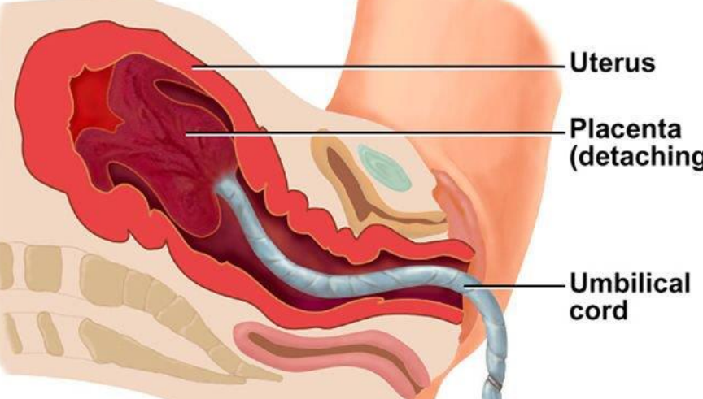

Slide 23
Cont….
Prolonged third stage of labor
>30 minutes - retained placenta (Prolonged third stage of labor)
PPH - this risk increases proportionally with increased duration.

Slide 24
Management Of 3rd Stage of Labor
Active (AMTSL):-
Early cord clamping
Controlled cord traction
Administration of a uterotonic agent
Manual removal or sharp curettage
Major operative interventions

Slide 25
Precipitous Labor
Extremely rapid labor and delivery.
Onset of labor to expulsion of the fetus - < 3 hours
Precipitated dilatation
Precipitated descent

Slide 26
Precipitous Labor Cont…
Possible reasons:-
Abnormally low resistance soft tissues
Abnormally strong uterine and abdominal contractions
Lack of pain with contractions to cue advanced labor (rare)
Complications :-
Unattended birth
Extensive lacerations of the cervix, vagina, vulva, or perineum -> Amniotic fluid embolism, PPH
Uterine rupture
Uterine atony – PPH
Low APGAR scores

Slide 27
What causes abnormal labor??

Slide 28
Etiologies Of Abnormal Labor
Causes are grouped into three distinct categories (The 3 P’s)
Abnormalities of
POWERS (Uterine Contractions & Maternal Effort)
PASSAGE (Maternal Pelvis & Reproductive Tract)
PASSENGER (The Fetus)
Act individually or in combination

Slide 29
Abnormalities Of The Powers
Primary power – Uterine contraction
Insufficiently strong or inappropriately coordinated to efface and dilate the cervix
Uterine dysfunction
Secondary power – Maternal expulsive efforts
During second stage : voluntary pushing efforts

Slide 30
Uterine Dysfunction (UD)
The most common cause of a protraction disorder
The lower limit of contraction pressure required to dilate a cervix has been observed to be 15 mmHg over baseline.
Normal spontaneous contractions often exert pressures up to 60 mm Hg.

Slide 31
Electromechanical Classification Of UD
Hypotonic dysfunction
Inefficient generation and propagation of action potentials through the myometrium or a lack of contractile response of myometrial cells to the initial stimulus.
Infrequent contractions of low amplitude
Low or normal baseline intrauterine pressures but synchronous contraction
Maternal discomfort is minimal.

Slide 32
Hypertonic dysfunction
Frequent contractions of low amplitude
Often associated with an elevated basal intrauterine Po
Primarily a condition of primiparas
Usually occurs in early labor
Maternal discomfort is usually significant

Slide 33
Risk Factors For Uterine Dysfunction
Neuraxial analgesia (Epidural…)
Chorioamnionitis
A higher station at the onset of labor
Maternal age
Maternal obesity
Parity
Fetal malpresentations / malpositions
Uterine pathologies (myoma, congenital anomalies)
Dehydration and electrolyte imbalances
Fetopelvic disproportion
Abruptio placentae with couvaliare uterus etc…

Slide 34
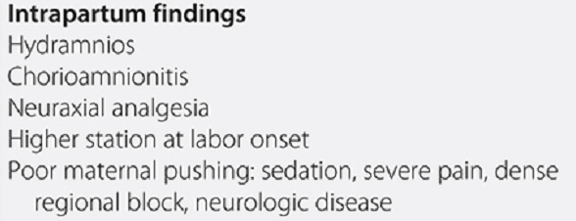

Slide 35
Abnormalities Of The Passage
The bony pelvis – inlet, midpelvis, outlet
Contracted Pelvis
Soft tissue dystocia

Slide 36
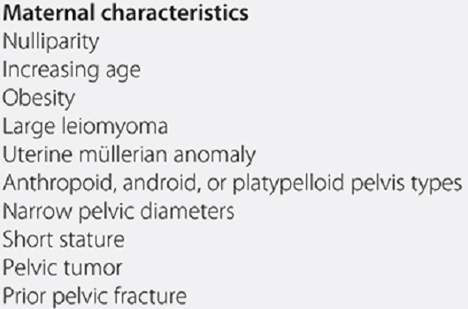
Risk Factors For Passage Abnormality

Slide 37
Abnormalities Of The Passenger
Malpresentations / Malpositions
Fetal weight
Fetal number
Fetal Congenital anomalies

Slide 38
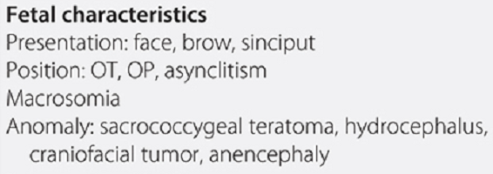
Risk Factors For Passenger Abnormality

Slide 39
Diagnosis
Follow & document the following parameters with time
Uterine contraction profile
Cervical dilatation/effacement
Descent of fetal presentation
Look into standard normal patterns for respective parity
Identify any deviations and then classify into respective abnormal patterns
Evaluate for any specific etiology by carefully assessing the three determinants of labor progress

Slide 40
Evaluation For Any Specific Cause
Assessment of the powers
Palpation of uterine contractions
External tocodynamometer
Intrauterine pressure catheter (IUPC) monitoring
Maternal exhaustion, vital signs, blood glucose and evidence of dehydration, emotional status and pain control
Assessment of the passenger
Size, number, presentation, position and anomalies of the fetus by Leopold's palpations and ultrasonography
Assessment of the passages
Bony pelvis – clinical pelvimetry
Soft tissue dystocia – vaginal exam

Slide 41
Management Summary
Power abnormalities
Uterine dysfunction – Augmentation, CD
Lack of maternal effort – Instrumental assistance
Passenger abnormalities
Often caesarean deliveries required
Destructive deliveries in cases of fetal deaths
Abnormalities of the passages
Often caesarean delivery
Episiotomy for perineal level obstruction

Slide 42
THANK YOU!

